Slide 1
Asynchronous
Software Studio 軟體設計與實驗
Hung-Kuo Chu
Department of Computer Science
National Tsing Hua University
CS2410

Slide 2
Goal
Fork the repo to your local repository
Complete the index.js
Deadline: 2020/04/09 18:00
Delay will get 40% off, 21:00 at the latest.
Add your folder to archive, add name as “Lab05_學號.zip” Ex: Lab05_106060004.zip
Upload to ftp.
If you want to upload new version, name your file as
“Lab05_學號_v2.zip”, and so on.

Slide 3
Goal
Data Generator
Follow get_info() and complete remain promise data generator: first name, last name, User name, email, address
Every generator’s success rate is 90% and random choose from three answers
First get_info, then get remain data
Use async / await
If automatic resample is checked, then retrieve the data again
If any data failed, show “failed” in txtInfoName

Slide 4
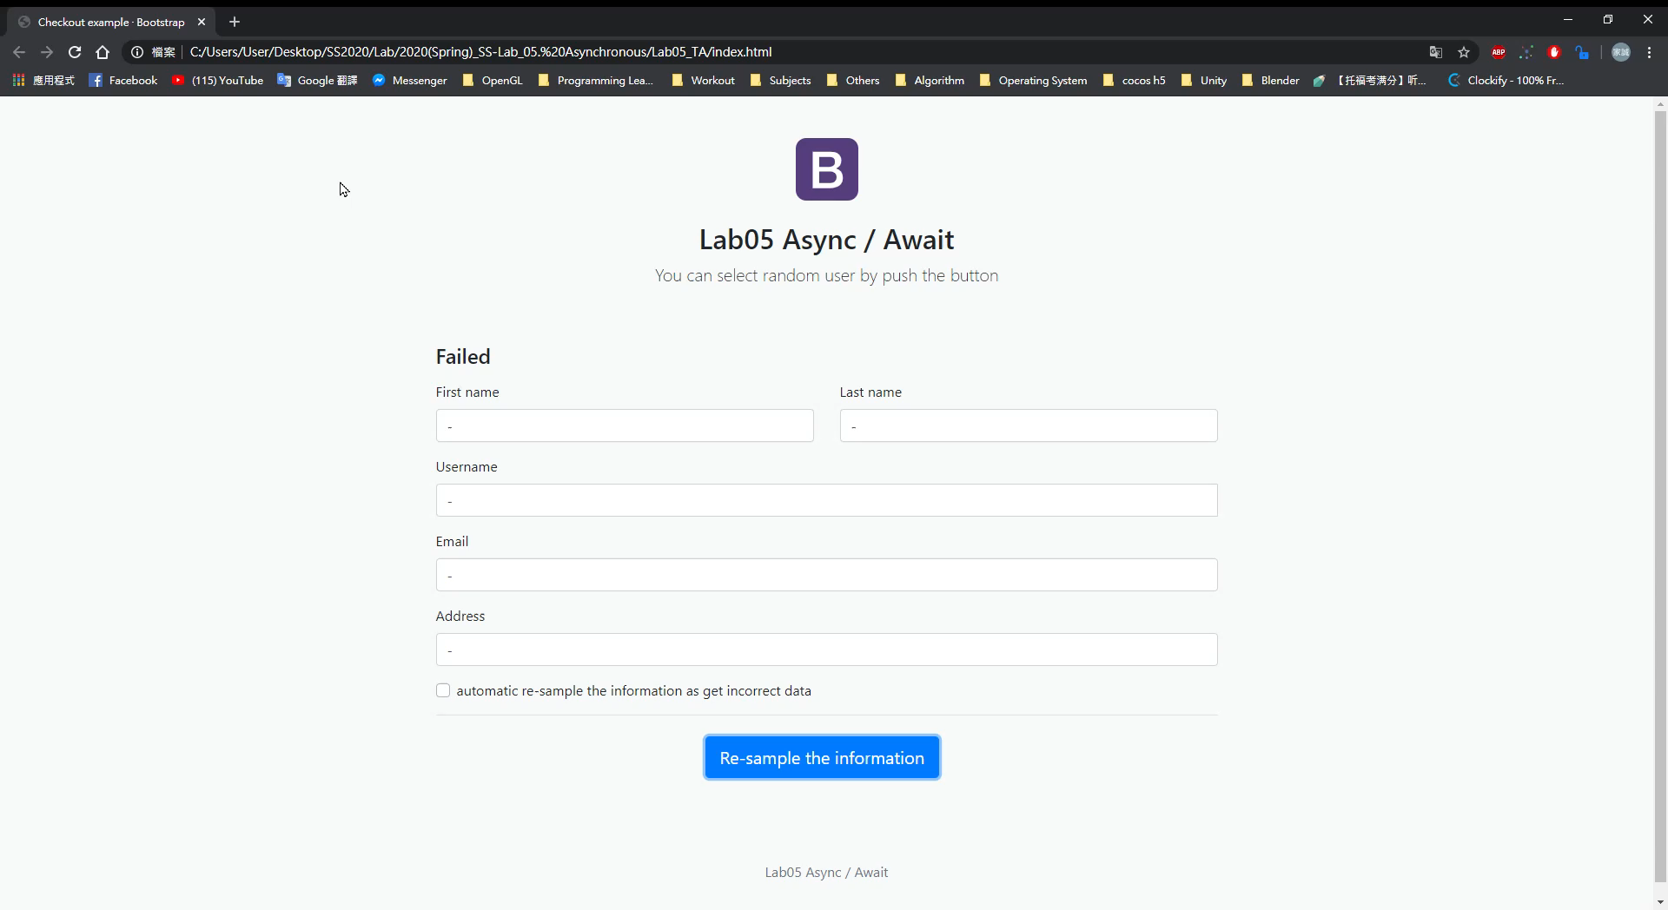
Goal example

Slide 5
Grading Policy
Generate data correctly 30%
Use async / await 25%
Generate get_info first, then other 5 data at the same time(Promise.all) 25%
Show failed in txtInfoName if any data failed 10%
Automatic resample when checked if failed 10%

